Slide 1

Entities, Symbols and Emojis
HTML

Slide 2
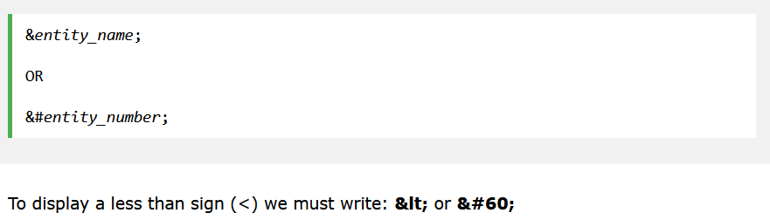
HTML Entities
They are reserved characters in HTML.
For example, when using angular brackets, the compiler may get confuse with the tags.

Slide 3
Advantage and dis-advantage
Advantage
_______ to remember
Disadvantage
Not all browsers may have _______ for names
Notes:
Easier
support

Slide 4
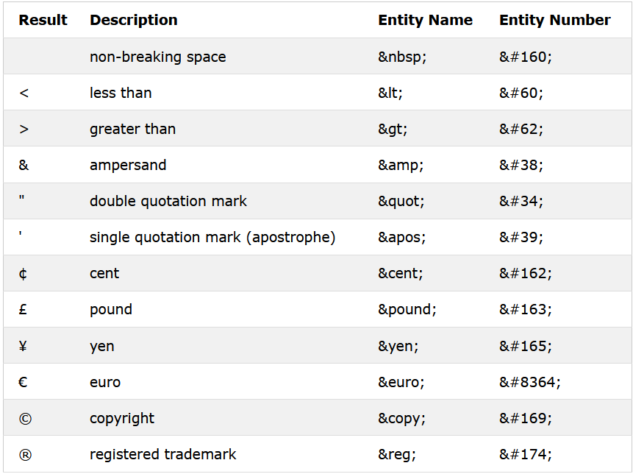
List of HTML character entities
Notes:
e.g. <p>3 &#160 5</p>

Slide 5
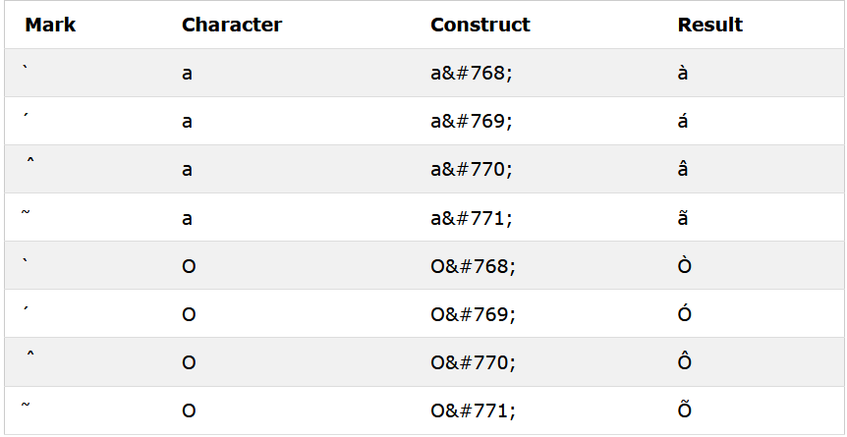
Combining Diacritical Marks

Slide 6
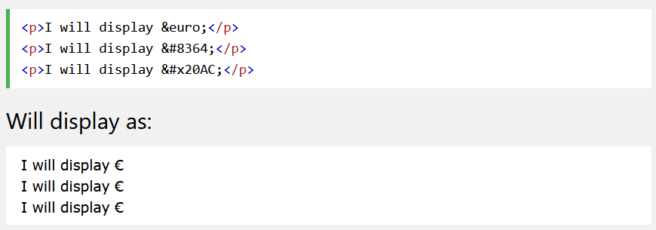
HTML symbols
They are reserved characters in HTML.
Used to display many of the mathematical, technical and currency symbols not present in any generic keyboard

Slide 7
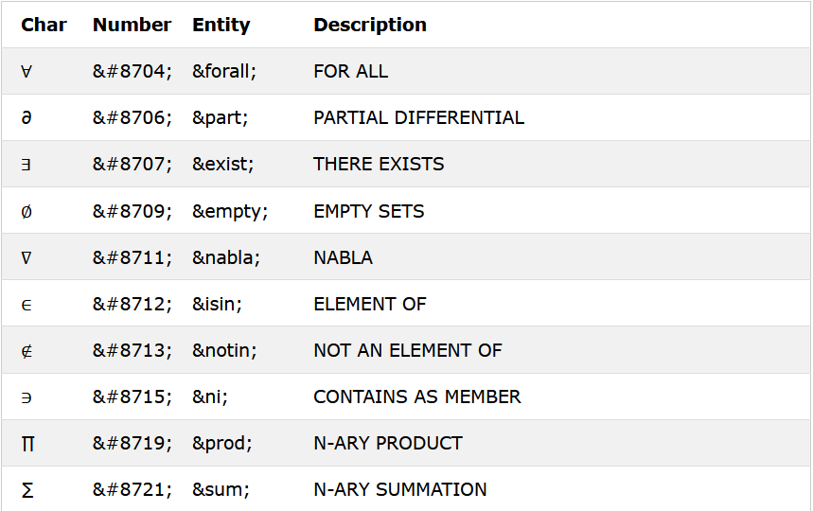
List of Mathe-matical symbols

Slide 8
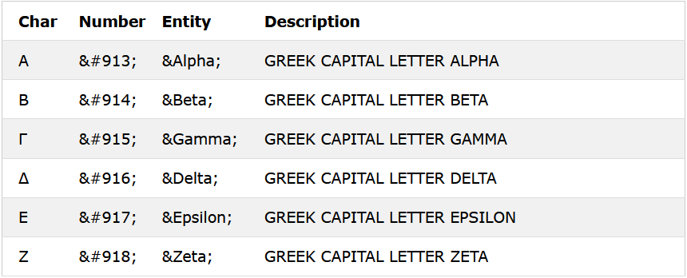
List of Greek character

Slide 9
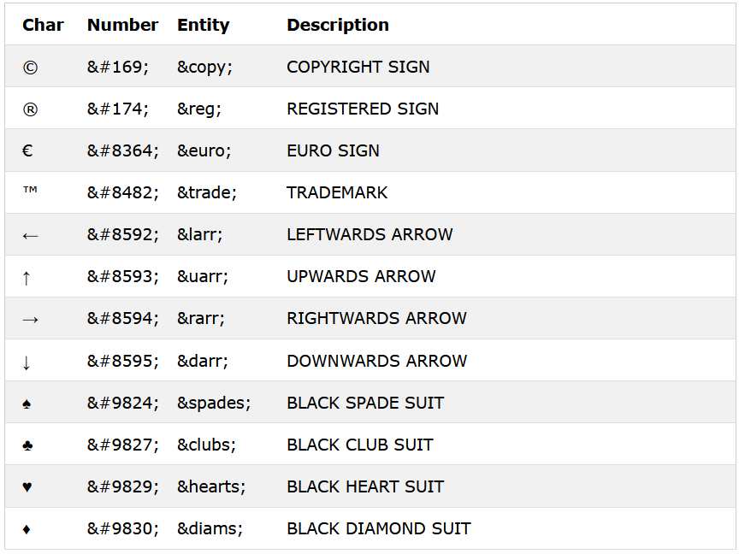
Additional entities

Slide 10

HTML emojis
They are reserved characters in HTML.
They are letters (characters) from the UTF-8 (Unicode)
That is why, we use “UTF-8” most of the time in <meta> tag

Slide 11
About utf-8 characters
Most characters are displayed using numbers (entity numbers)
E.g. A is 65.
<!DOCTYPE html> <html> <head> <meta charset="UTF-8"> </head> <body> <p>I will display A B C</p> <p>I will display &#65; &#66; &#67;</p> </body> </html>

Slide 12
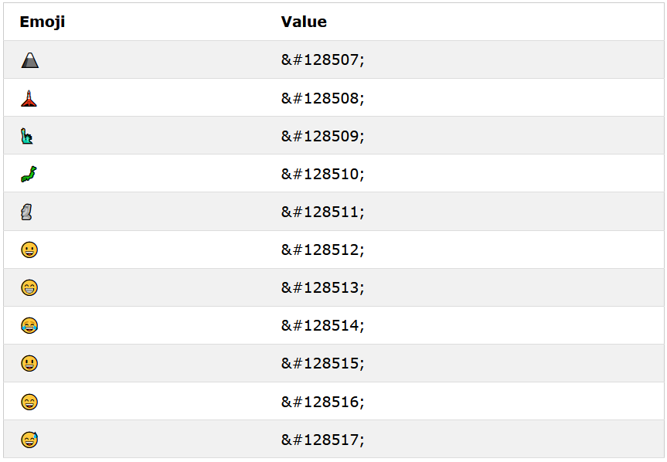
List of emojis

Slide 13
disclaimer
All these lists are non-exhaustive.
There are more characters available in the HTML language.
However, it would take up too much time if we were to go through the 1 by 1.
Hence, do your due-diligence and go a search if you need those numbers!

